Slide 1
Final Project Part1
Raghunath Sai Puttagunta
Student Id-16207717

Slide 2
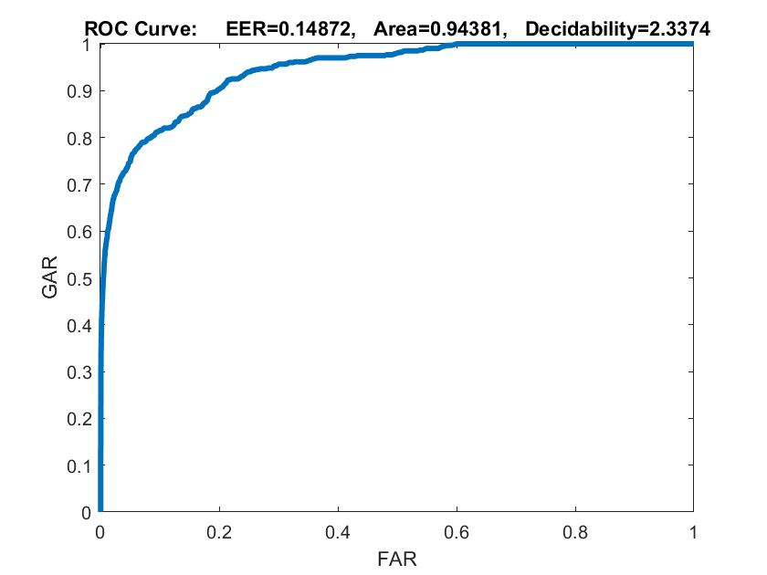
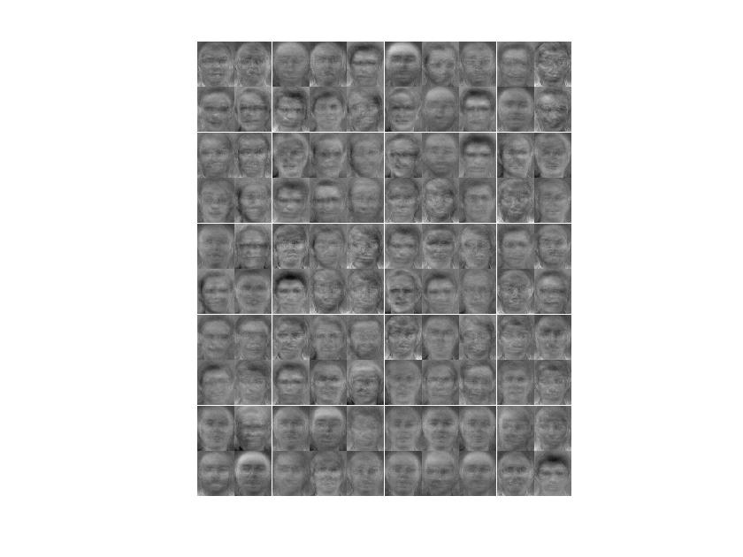
Hid=100,L2W=0.004, Sparsity reg= 1 Sparsity Proportion=0.25 ratio=168.0032

Slide 3
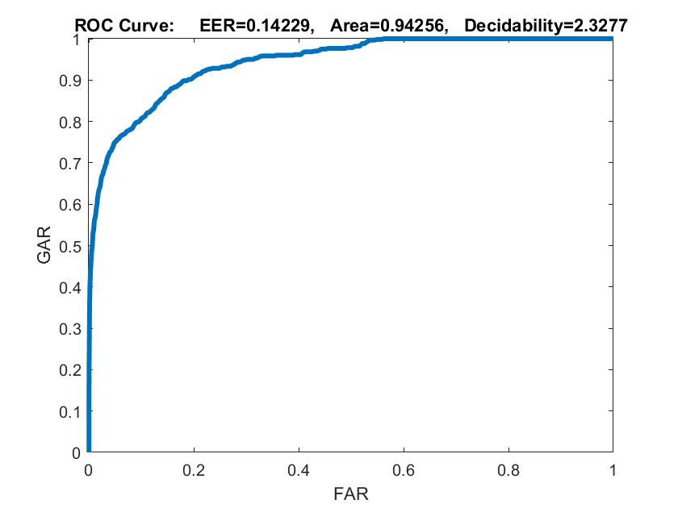

Hid=100,L2W=0.008, Sparsity reg= 1 Sparsity Proportion=0.25 ratio=180.2061

Slide 4


Hid=100,L2W=0.004.Sparsity reg=2,Sparsity prop=0.25 ratio= 204.8861

Slide 5


Hid=100,L2W=0.004, Sparsity reg= 1 Sparsity Proportion=0.15 ratio=224.1330

Slide 6

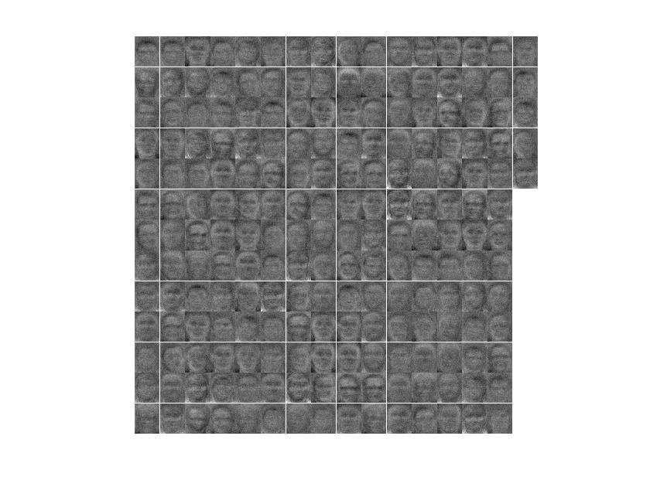
Hid=200,L2W=0.004, Sparsity reg= 1 Sparsity Proportion=0.25 ratio=183.0244

Slide 7

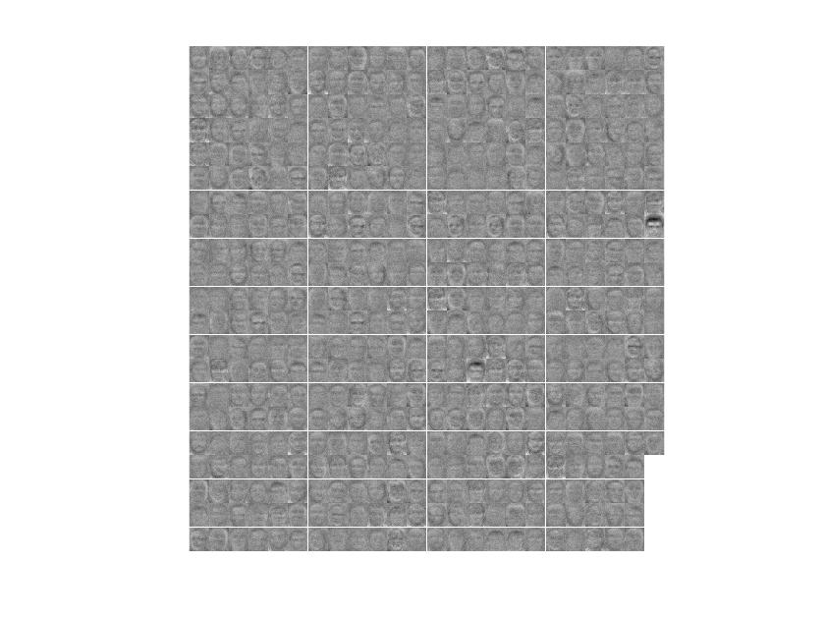
Hid=500,L2W=0.004, Sparsity reg= 1 Sparsity Proportion=0.25 ratio=208.4895

Slide 8

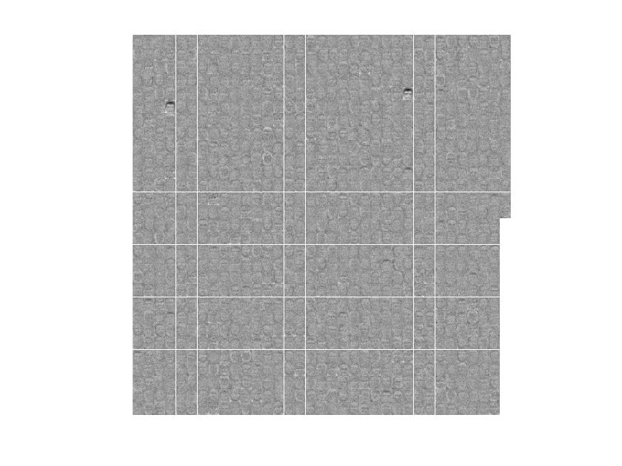
Hid=1000,L2W=0.004, Sparsity reg= 1 Sparsity Proportion=0.25 ratio=196.3167

Slide 9
Results
Hidden Layer Sizes | L2W Regularization | Sparsity Regularization | Sparsity Proportion | AUC’s | Ratio
100 | 0.004 | 1 | 0.25 | 0.94381 | 168.0032
100 | 0.008 | 1 | 0.25 | 0.94256 | 180.2061
100 | 0.012 | 1 | 0.25 | 0.93698 | 175.9704
100 | 0.004 | 2 | 0.25 | 0.93943 | 204.8861
100 | 0.004 | 4 | 0.25 | 0.91482 | 153.4679
100 | 0.004 | 1 | 0.15 | 0.94352 | 224.1330
100 | 0.004 | 1 | 0.50 | 0.93692 | 165.6491
200 | 0.004 | 1 | 0.25 | 0.9442 | 208.4895
300 | 0.004 | 1 | 0.25 | 0.94372 | 177.6204
500 | 0.004 | 1 | 0.25 | 0.9425 | 183.0244
1000 | 0.004 | 1 | 0.25 | 0.94631 | 196.3167

